Slide 1
How might AI assist both TCE faculty and students in this 4 year transformational process?
The 'work' is the same 'to create critically conscious curriculum makers'... yet how might we leverage AI to accomplish this goal?

Slide 2
AI Integration Across the Program
Example Assignments
Competency Progression
TCE 191 (Beginning)
Analyze AI bias & limitations in educational tools
Course | Focus | Level
TCE 191 | Ethical & critical examination of AI | Introduce
Methods | Structured AI use in analysis | Guided Application
Capstone | AI embedded in authentic decision-making | Integrated Practice
Methods (Middle)
Use AI to analyze language demands in math tasks & compare AI-generated vs. human-designed supports
Capstone/Internship (Advanced)
Assessment Case Study: Use AI or human feedback to analyze student learning & design responsive instruction

Slide 3
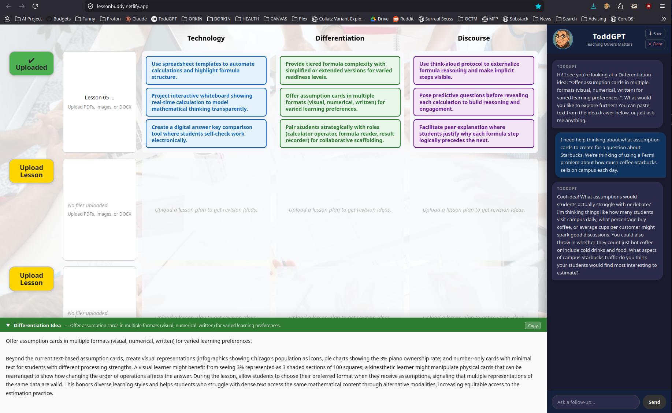
AI in Action: LessonBuddy for Lesson Planning

Slide 4
Revised Program Outcomes: AYA Integrated Mathematics (Grades 7-12)
ORIGINAL | REVISED
Apply knowledge of mathematics content to critique the reasoning of others. | Apply knowledge of mathematics content to critique the reasoning of others.
Use the language of mathematics to express mathematical ideas to multiple audiences. | Use the language of mathematics to express mathematical ideas to multiple audiences.
Make instructional decisions using formative assessments. | Make instructional decisions using formative assessments and appropriate technologies.
Analyze and apply existing research in planning instruction. | Analyze and apply existing research and technologies in planning instruction.
Utilize resources from professional mathematics education organizations to inform practice. | Utilize resources from professional mathematics education organizations to inform practice.
Utilize professional development resources to inform lesson planning. | Utilize professional development resources to inform lesson planning.

